Slide 1
INTERNSHIP PROJECT REPORT
TITLE - Employee Attrition Analysis
NAME - ALWAR VIGNESH N
DATA ANALYST
www.sadhvisoft.com
©2024 Sadhviacademy

Slide 2
TABLE OF CONTENTS
INTRODUCTION
DETAILS OF DATA
TOOLS USED
SCREENSHOTS
MY DESIGN
CONCLUSION

Slide 3
INTRODUCTION:
Employee attrition, often underestimated, can rapidly jeopardize successful organizations. While hiring receives significant attention, addressing the reasons for top talent departure is crucial. This analysis provides practical insights for employers to understand and rectify issues before they harm the organization, preventing rising turnover rates, declining productivity, and uncertainty about the company's future.

Slide 4
DETAILS OF DATA:
Exploratory Data Analysis (EDA) involves examining and summarizing key characteristics of a dataset to gain insights and identify patterns.
In the analysis of employee attrition, we aim to explore relationships between attrition and these attributes, aiding in the identification of factors that could contribute to employee turnover

Slide 5
TOOLS USED:
PANDAS
MATPLOTLIB
SEABORN
POWER BI

Slide 6
TASKS:
IDENTIFY Overall Attrition Rate
IDENTIFY Top 5 Departments with Highest AND LOWEST Attrition Rates
IDENTIFY Relationship between Employee Satisfaction and Attrition.
IDENTIFY Attrition Rate by Job Level
IDENTIFY Relationship between Age and Attrition.
Compare Attrition Rates by Job Role
Compare Attrition Rates by Education Level
Compare Attrition Rates by Gender
Relationship Between Work Environment and Attrition

Slide 7
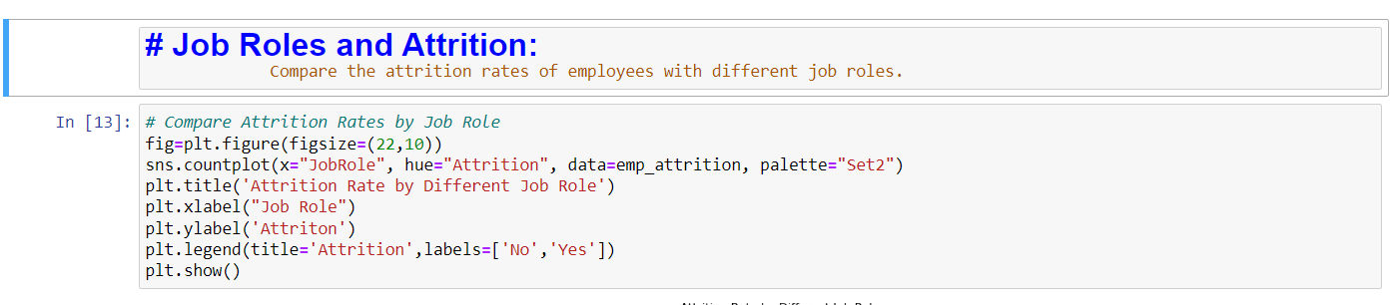
SCREENSHOTS:

Slide 8
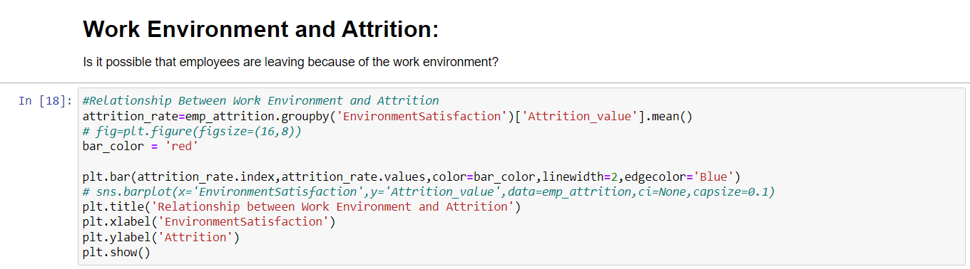

Slide 9
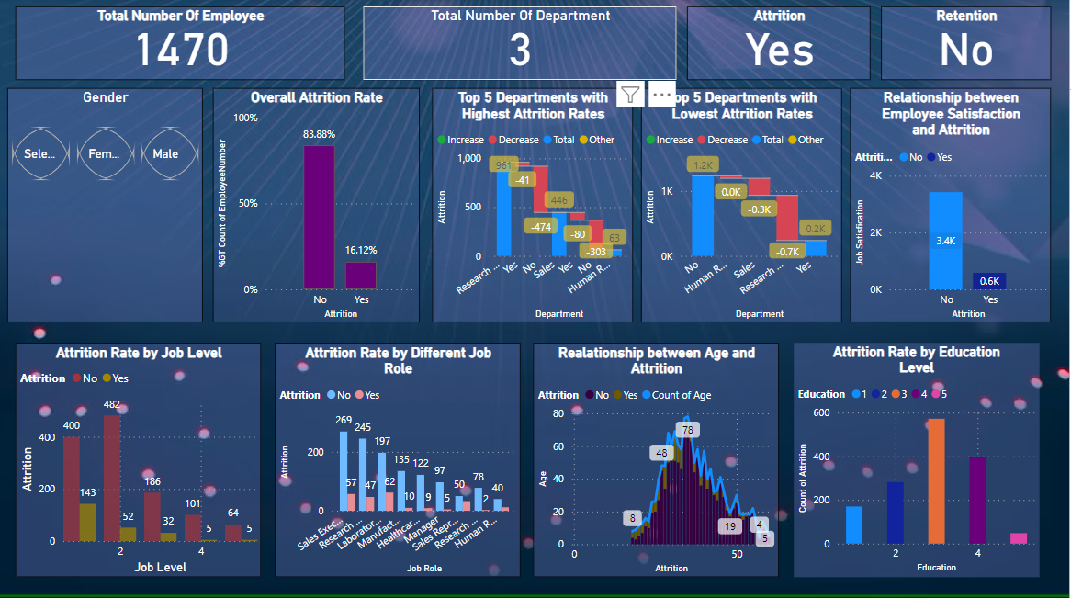
MY DESIGN:

Slide 10
CONCLUSION:
In conclusion, the methods employed in the data analysis of the given dataset were effective in providing insights into the data distribution.
The challenges encountered during the implementation of the methods provided valuable lessons for future works.

Slide 11
THANKYOU

